Slide 1


SecondHand Vehicles Recommended System
BY R.Purna sambasivarao
AP22110010254
CSE-L

Slide 2

CONTENT
01
INTRODUCTION TO RECOMMENDER SYSTEMS
02
TYPES OF RECOMMENDER SYSTEMS
03
OVER VEW OF SECOND-HAND VEHICLES RECOMMENDED SYSTEM
04
SECOND-HAND VEHICLES RECOMMENDED SYSTEM
05
CASE STUDY
06
METRIC AND RESULT ANALYSIS

Slide 3


RECOMMENDER SYSTEMS
A Secondhand Vehicles Recommendation System helps users find pre-owned vehicles that best meet their needs and preferences. It leverages data like vehicle price, mileage, model, condition, location, and user feedback to suggest options that match individual criteria.
THE SYSTEM TYPICALLY INVOLVES DATA COLLECTION FROM VARIOUS VEHICLE LISTINGS, PROCESSING, AND FILTERING USING PREDEFINED OR USER-SPECIFIED CRITERIA, AND FINALLY DISPLAYING RECOMMENDATIONS IN AN ACCESSIBLE FORMAT.

Slide 4





TYPES OF RECOMMENDER SYSTEMS
Content-Based Filtering
Collaborative Filtering
Hybrid Recommender Systems
Recommends items similar to those a user has shown interest in, based on features like genre, category, or specific attributes. For example, if a user likes action movies, the system will recommend other action movies.
Uses the preferences and behaviors of similar users to recommend items. There are two main types
Combines multiple recommendation approaches, often content-based and collaborative filtering, to improve recommendation accuracy.

Slide 5

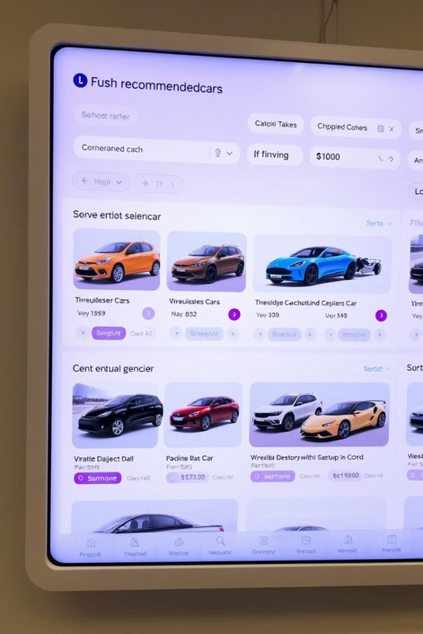
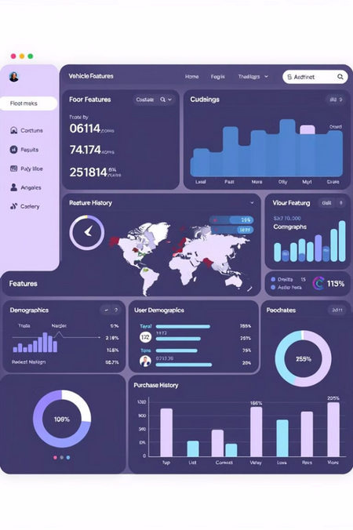
OVERVIEW OF SECONDHAND VEHICLES RECOMMENDED SYSTEM
Mission
A Secondhand Vehicles Recommendation System assists buyers in finding suitable pre-owned vehicles by analyzing data such as price, mileage, condition, and location. It helps narrow down options based on the user's preferences, enhancing decision-making by presenting vehicles that meet specific criteria. This system reduces time spent on searching and increases the likelihood of a satisfactory purchase.
Vision
The recommendation system often uses algorithms like content-based and collaborative filtering to provide suggestions. By analyzing user interactions, feedback, and market trends, the system can recommend vehicles that align with user preferences. This approach personalizes the search experience, making it efficient and tailored to individual needs.

Slide 6
SECONDHAND VEHICLES RECOMMENDED SYSTEM
A Secondhand Vehicles Recommendation System is designed to help buyers find the best pre-owned vehicles based on their specific needs and preferences. It simplifies the search by presenting users with relevant vehicle options, considering factors like price range, mileage, model, brand, and location. This system can be invaluable in a market with numerous options, where finding a suitable vehicle can otherwise be overwhelming.

Slide 7
Case Study:-AutoFind – A Personalized Secondhand Vehicle Recommendation Platform
AutoFind is an online platform that connects buyers with secondhand vehicles listed by dealers and individuals. With an expanding database of thousands of cars across various regions, AutoFind realized that users were struggling to find the right car due to overwhelming options. To address this, they implemented a recommendation system to make the buying process easier and more personalized.
AutoFind’s recommendation system proved to be a valuable tool for both users and the business. By effectively narrowing down choices and personalizing options, the system provided a streamlined and satisfying buying experience. This case study demonstrates how recommendation systems can drive customer satisfaction, engagement, and business growth in the competitive secondhand vehicle market.

Slide 8
Problems without Collaborative Filtering in a Secondhand Vehicles Recommendation System:
Limited Personalization: The system would provide generic recommendations without understanding user preferences. Users would have to manually search for vehicles, leading to lower engagement and satisfaction.
Reduced Discoverability of Relevant Options: Users might miss out on vehicles they might like because recommendations would be based solely on search terms or pre-set filters rather than on other users’ similar preferences.
Decreased User Engagement: Without personalized recommendations, users are less likely to find relevant options quickly, which could result in frustration and reduced platform usage.
Cold Start Challenges: New users and newly listed vehicles would struggle to gain visibility, as recommendations wouldn’t be based on patterns learned from similar users.

Slide 9
Implementation of Collaborative Filtering in a Secondhand Vehicles Recommendation System
Step 1: Data Collection
The system gathers data on user interactions, such as vehicle views, saves, shares, and inquiries. It also collects user profile information, such as preferred price range, location, and vehicle type, along with vehicle metadata (make, model, year, mileage).
Step 2:
Create User-Item Interaction Matrix
The data is organized into a user-item matrix where:
Rows represent users.
Columns represent vehicles.
Cells contain engagement metrics, like views or saves, to capture user interest.
Step 3:
Implementing Cosine Similarity
To calculate user similarity, the system:
Normalizes user interaction vectors.
Computes cosine similarity scores for user pairs.
Builds a similarity matrix to identify clusters of users with similar interests.

Slide 10

METRICS AND RESULT ANALYSIS USED
Key Metrics
Click-Through Rate (CTR)
Measures the percentage of recommended vehicles that users click on. A higher CTR indicates that recommendations are relevant and engaging for users.
Conversion Rate
Tracks the percentage of recommended vehicles that result in inquiries, test drives, or purchases. This metric is essential for understanding if recommendations lead to actual interest or sales

Slide 11




RESULT ANALYSIS USED IN A SECONDHAND VEHICLES RECOMMENDATION SYSTEM:
Employs graphs and charts to display trends in metrics like click-through rate and conversion rate over time, helping identify patterns, peaks, or drops in engagement and recommendations.
Analyzes metrics across various user segments, such as budget-conscious versus high-budget users or new versus returning users, to understand how different user types respond to recommendations.
Actively monitors real-time user interactions, updating algorithms based on observed engagement, preference shifts, and seasonal trends in vehicle purchases, ensuring relevance and accuracy of recommendations.
SEGMENTATION ANALYSIS:
CONTINUOUS FEEDBACK LOOP
DATA VISUALIZATION

Slide 12

THANK YOU

